Slide 1
PHP, Apache, Mysql download

Slide 2
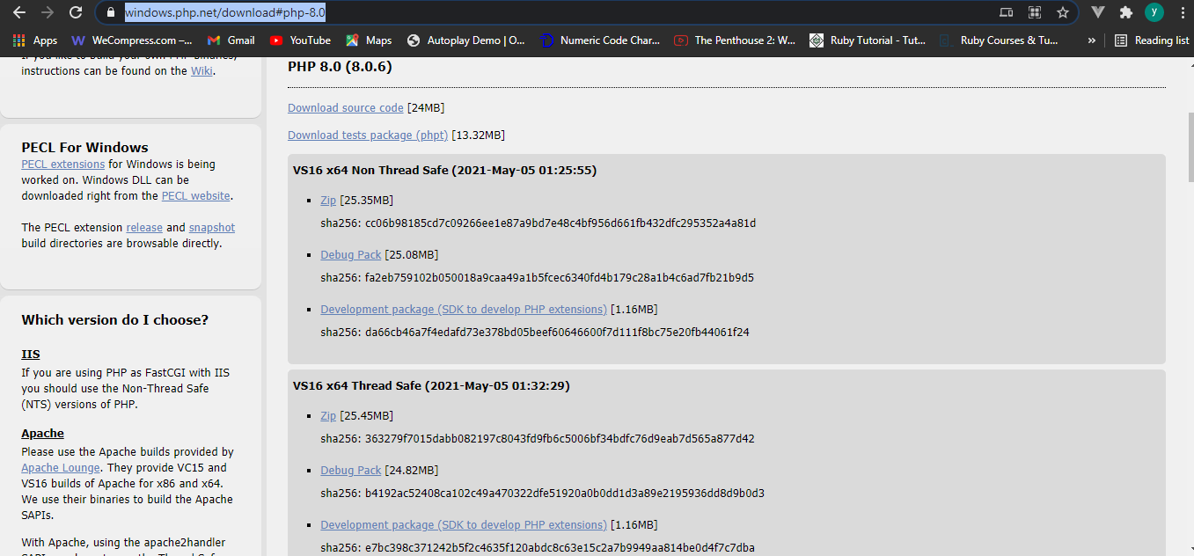
PHP
Download link: https://windows.php.net/download#php-8.0 (download treat version -zip)

Slide 3
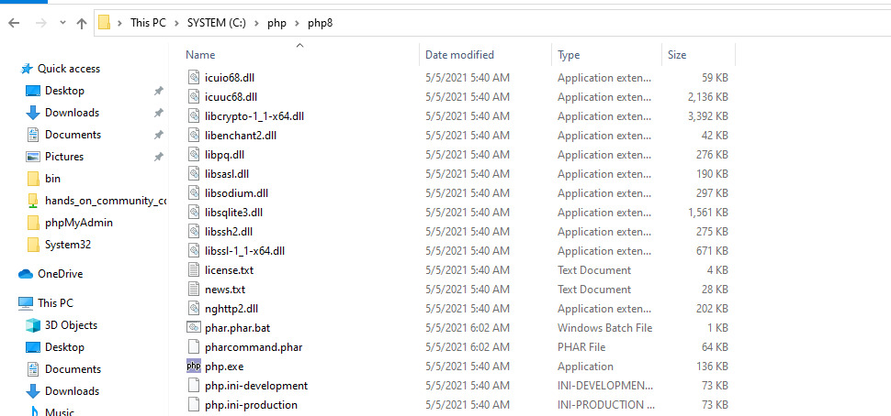
To Search path route;

Slide 4
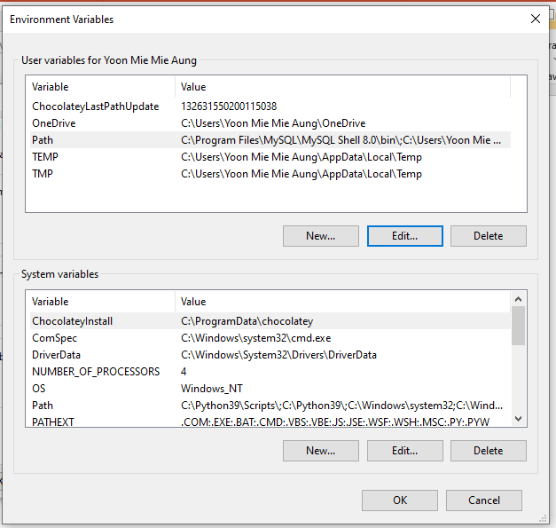
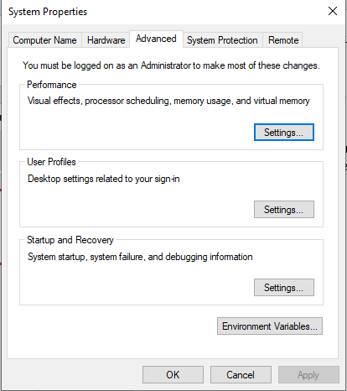
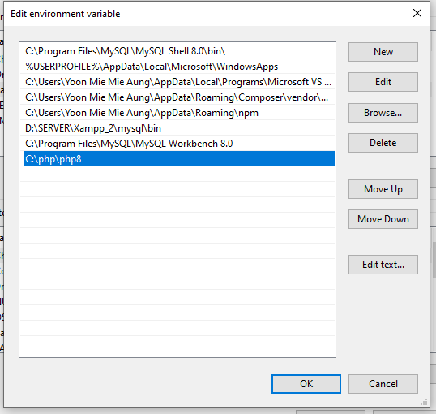

Slide 5
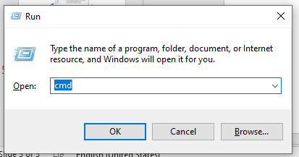
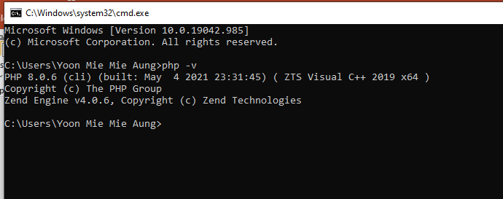
Output;

Slide 6
Apache
https://www.sitepoint.com/how-to-install-apache-on-windows/

Slide 7
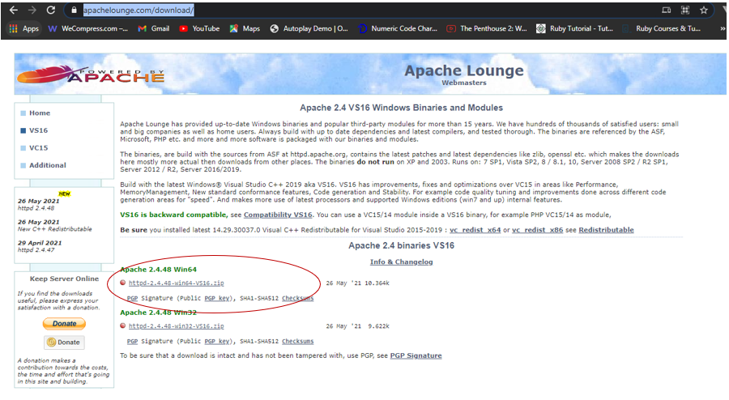
Download Link : https://www.apachelounge.com/download/
And download Apache 2.4.40 Wind 64

Slide 8
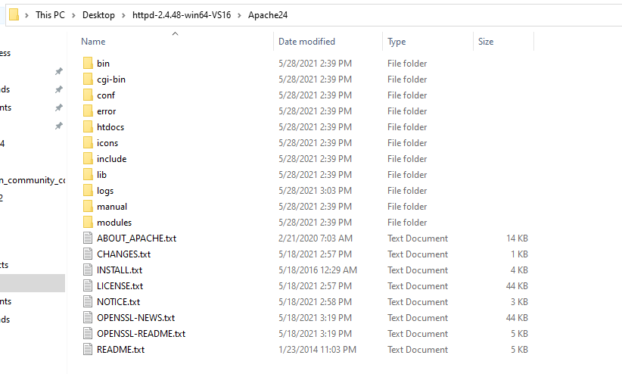
My file location(apache location)

Slide 9
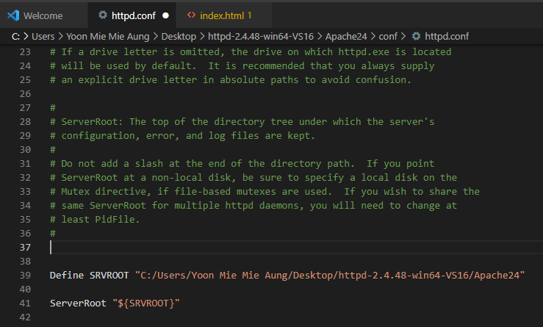
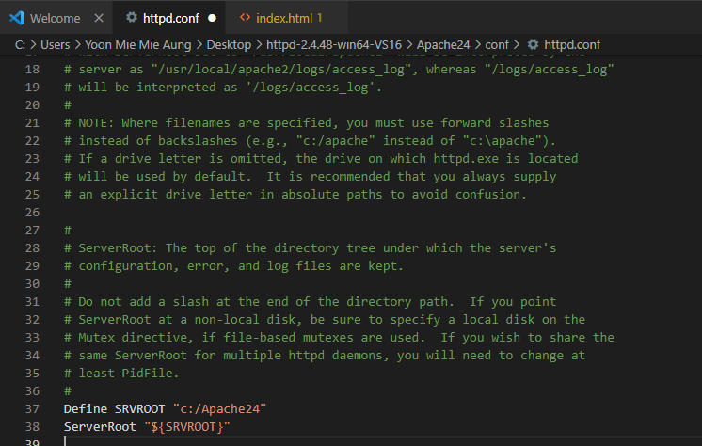
In httpd.conf file;
Change serverroot to the original path

Slide 10
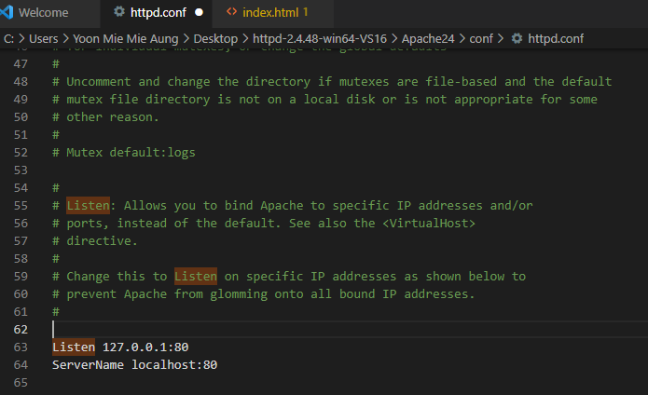
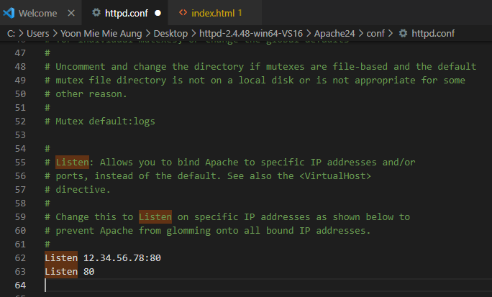
In httpd.conf file;
Change servername

Slide 11
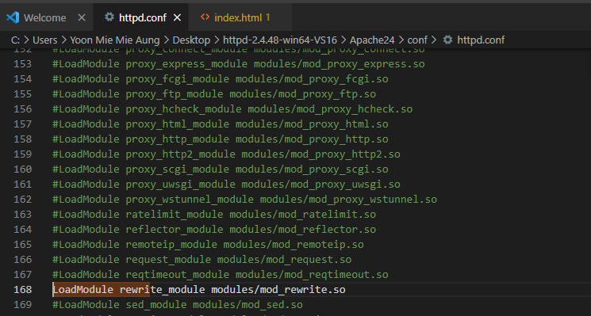
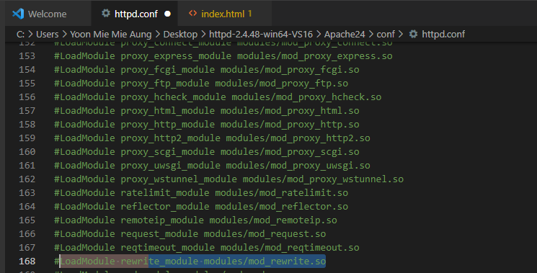
In httpd.conf file;
Open the command of LoadModule rewrite_module modules/mod_rewrite.so

Slide 12
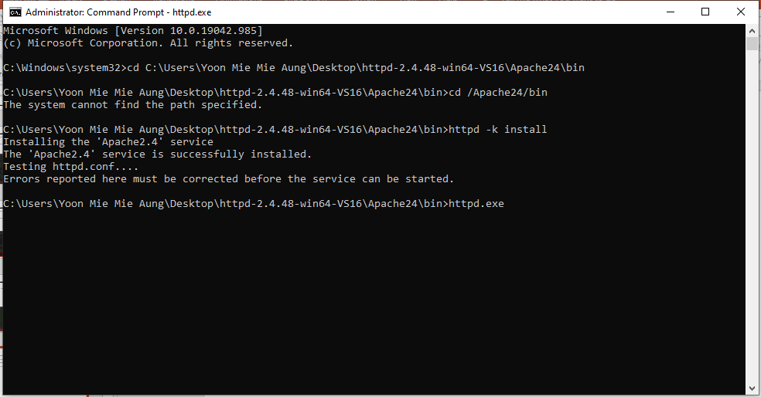
Install apache

Slide 13

Output: Run the given host name in Url (http://localhost:80/)

Slide 14
Connect php with apache
Add php.ini file in php folder
Connect php in httpd-2.4.48-win64-VS16\Apache24\conf\httpd.conf
Restart apache
Run apache in command line

Slide 15
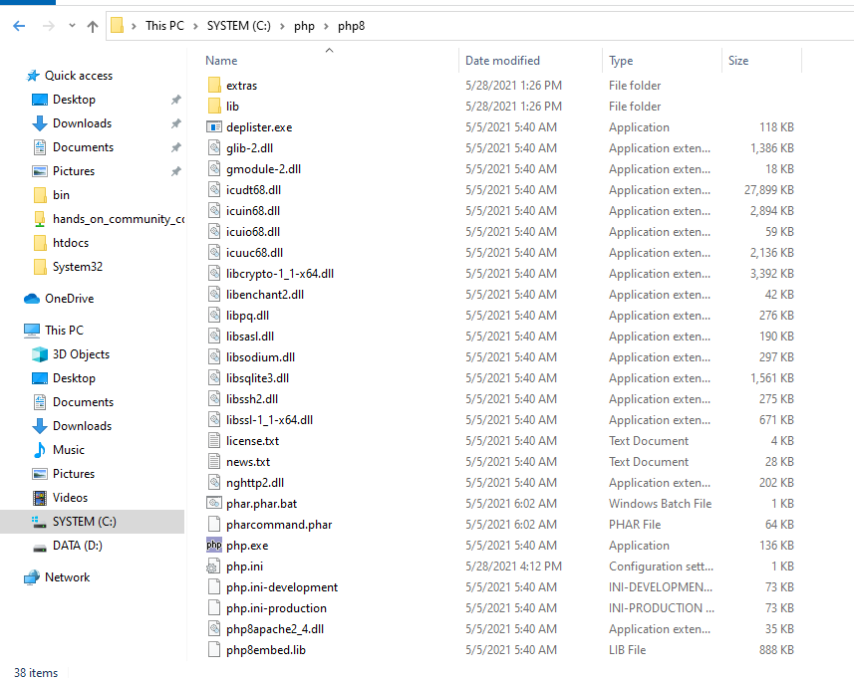
Add php.ini file in php folder

Slide 16
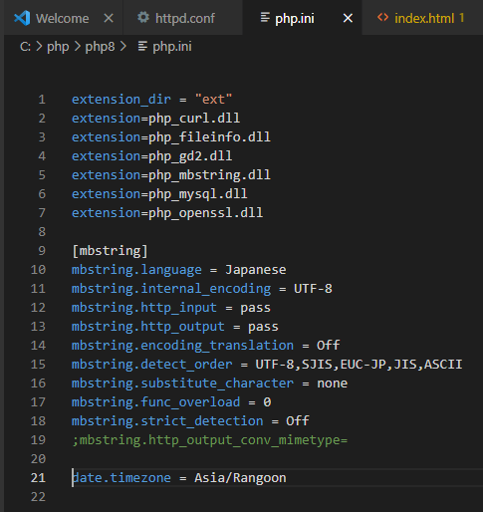
In php.ini file;

Slide 17
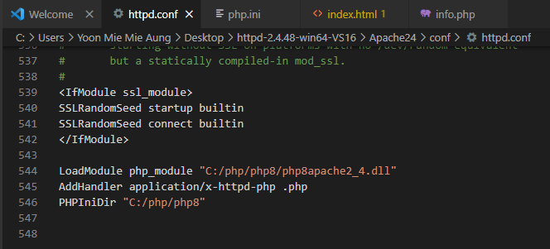
In httpd.config file; (httpd-2.4.48-win64-VS16\Apache24\conf\httpd.conf)

Slide 18
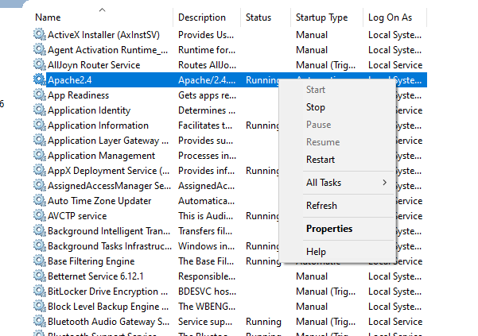
Restart apache and run apache with command line

Slide 19
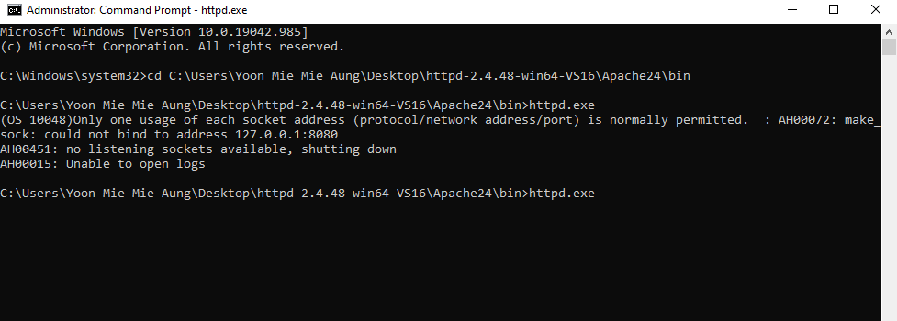
Run apache in command line

Slide 20
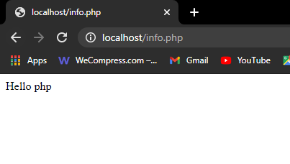
Output;

Slide 21
My SQL

Slide 22
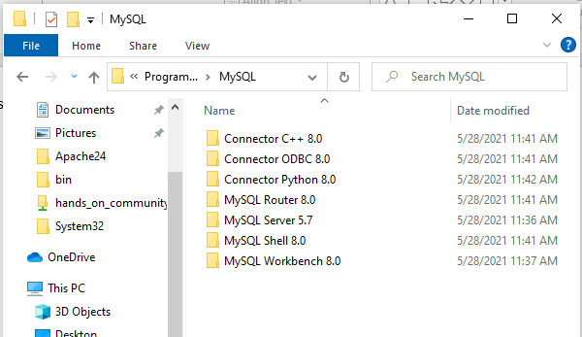
Just install the mysql installer

Slide 23
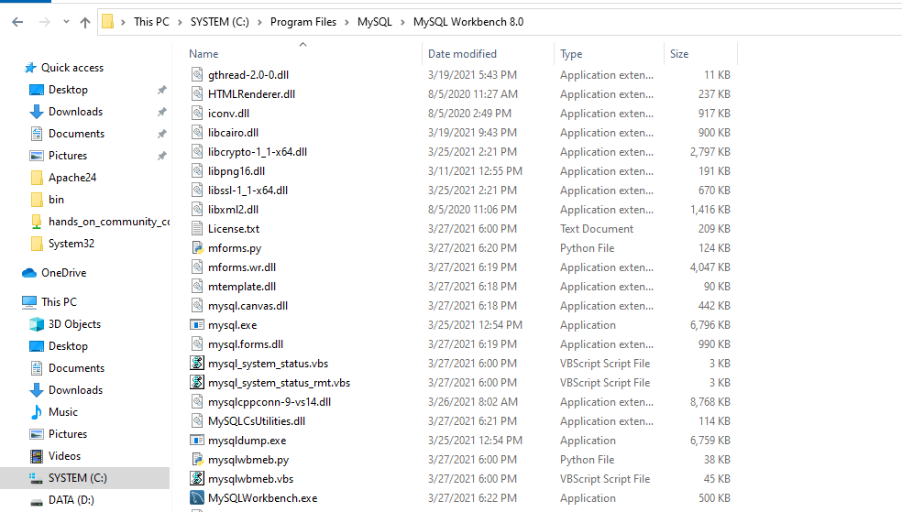
MySql Route;

Slide 24
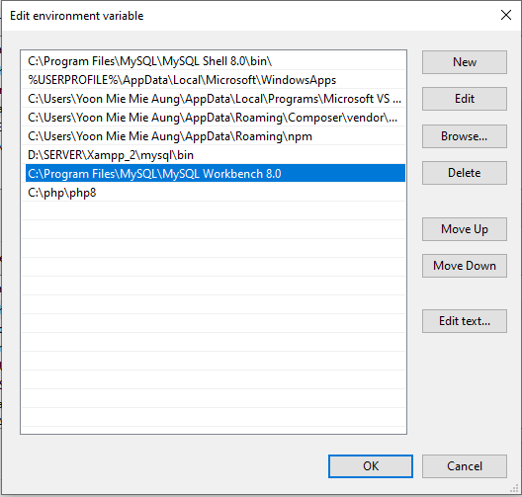

Slide 25
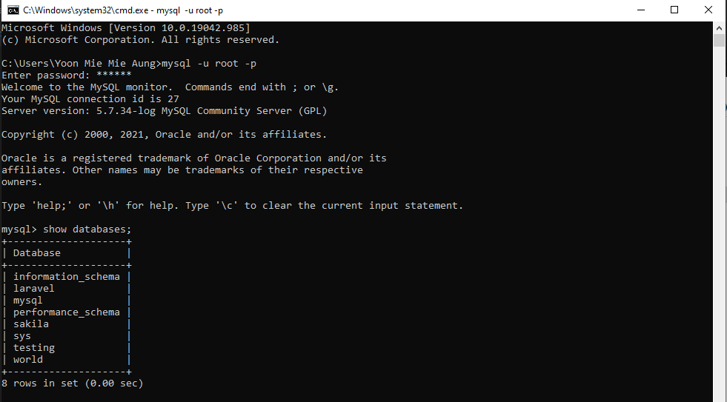
Output;

